Slide 1
Computer Vision
FALL 2020
Problem Set #3
Parin Patel
pptal480@gatech.edu
Computer Vision @ GT

Slide 2
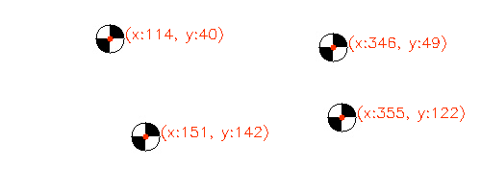
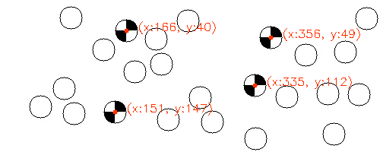
1: Marker detection
ps3-1-a-1
ps3-1-a-2
Computer Vision @ GT

Slide 3
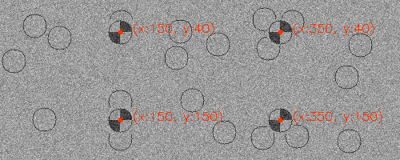
1: Marker detection (cont.)
ps3-1-a-3
Computer Vision @ GT

Slide 4
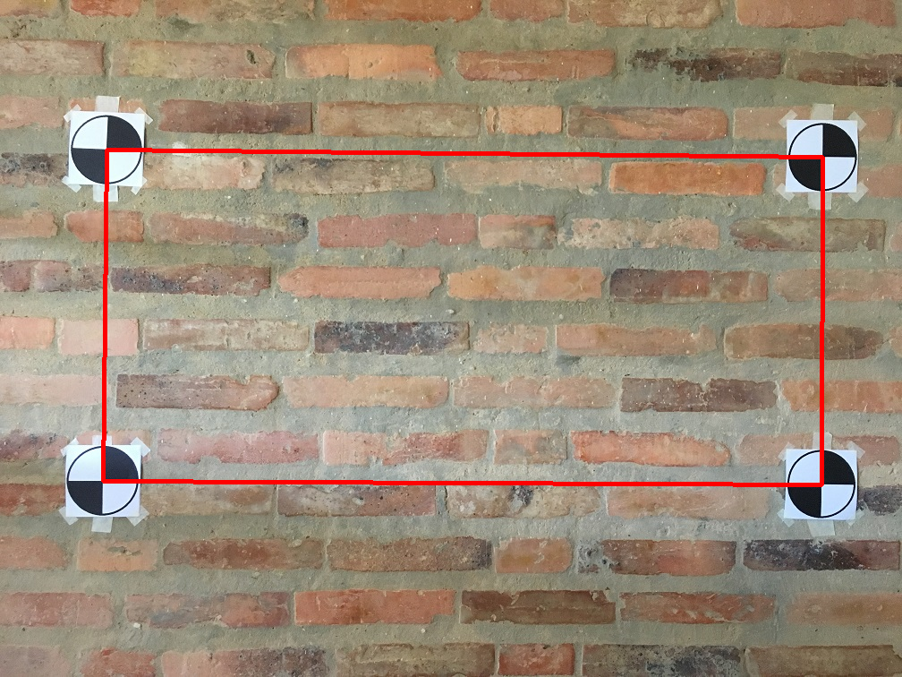
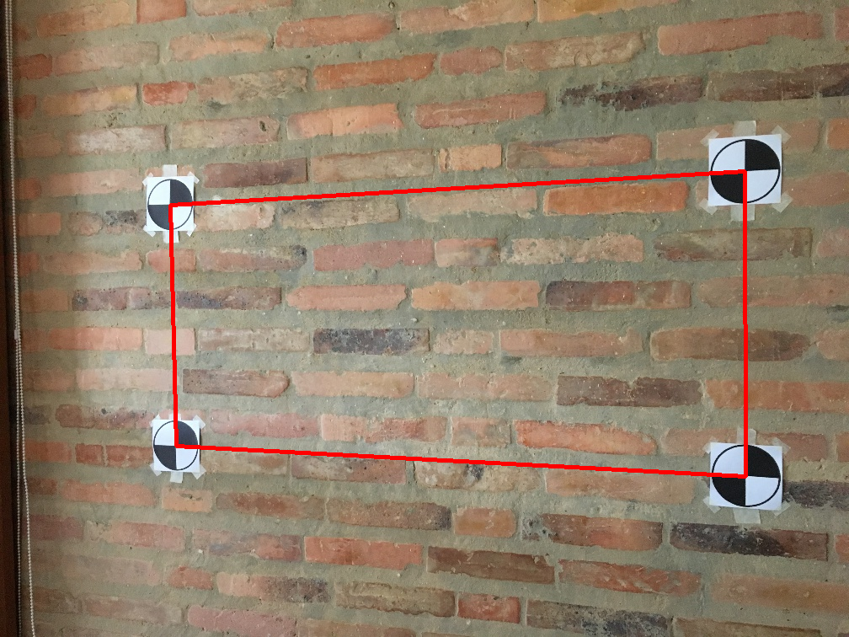
2: Marker detection (wall scene)
ps3-2-a-1
ps3-2-a-2
Computer Vision @ GT

Slide 5
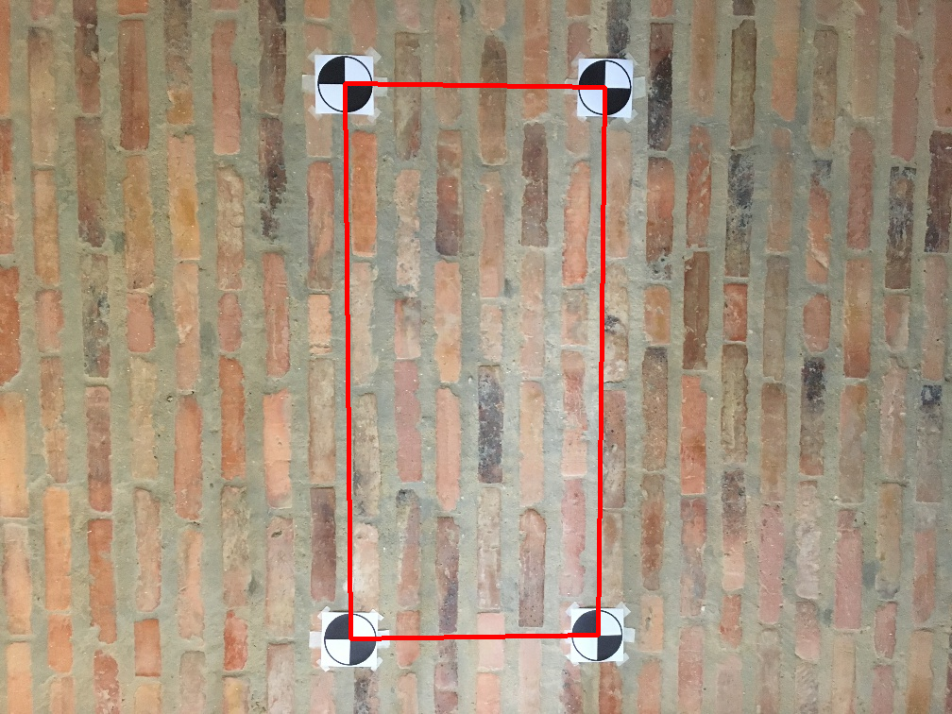
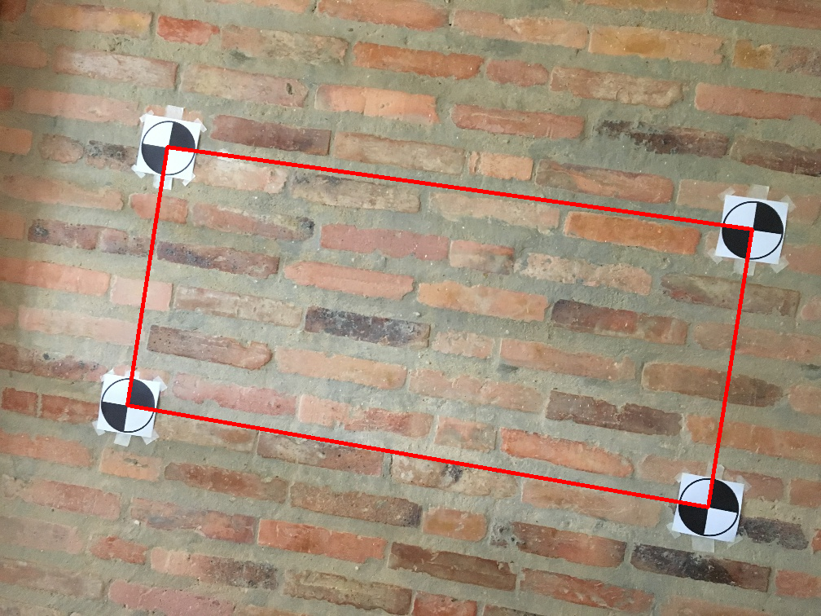
2: Marker detection (wall scene)
ps3-2-a-3
ps3-2-a-4
Computer Vision @ GT

Slide 6
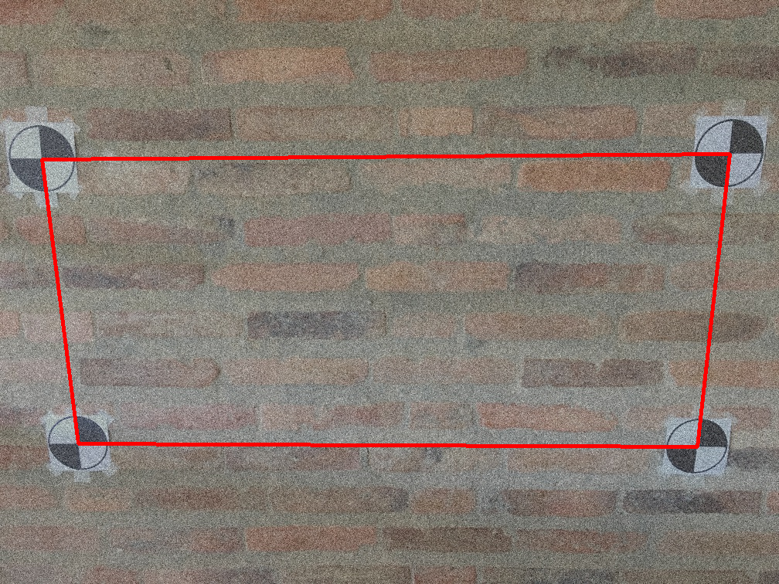
2: Marker detection (wall scene)
ps3-2-a-5
Computer Vision @ GT

Slide 7


3: Projective Geometry
ps3-3-a-1
ps3-3-a-2
Computer Vision @ GT

Slide 8

3: Projective Geometry (cont.)
ps3-3-a-3
Computer Vision @ GT

Slide 9
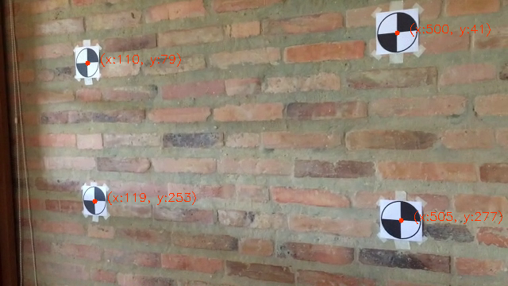
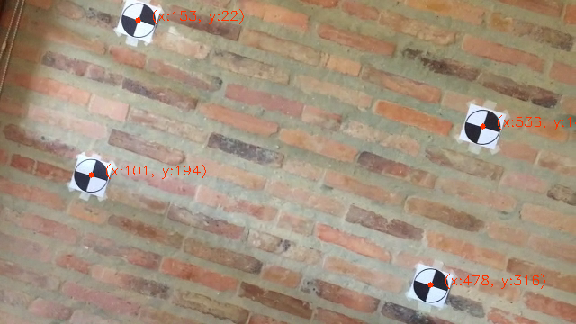
4: Markers in Video
ps3-4-a-1
ps3-4-a-2
Computer Vision @ GT

Slide 10
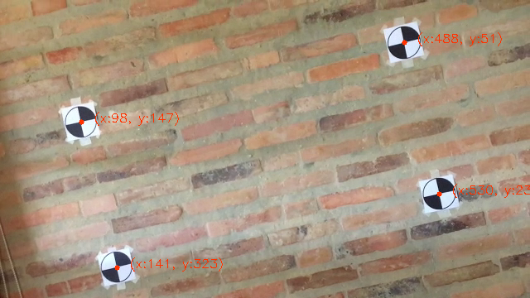
4: Markers in Video (cont.)
Youtube / Dropbox / etc. link:
https://gtvault-my.sharepoint.com/:v:/g/personal/ppatel480_gatech_edu/EVIV8Uic0JxAtXIKnOhmp8MBQ1HBhuhdJouJvdaynECB0g?e=IenWsk
Short Link : Here
ps3-4-a-3
Computer Vision @ GT

Slide 11
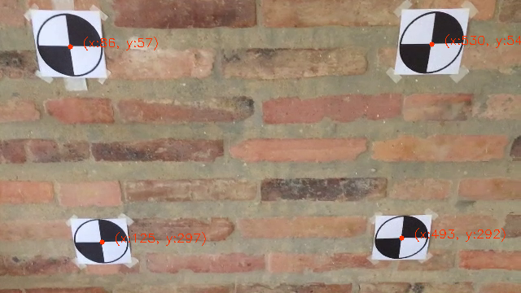
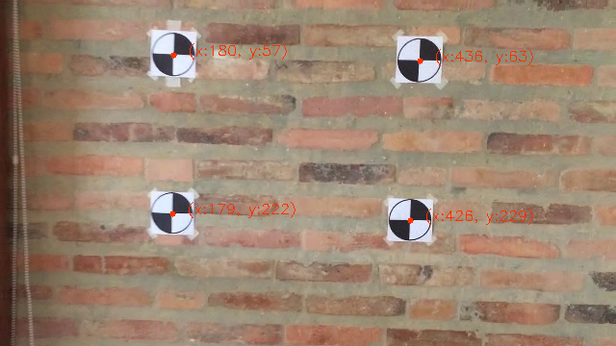
4: Markers in Video (cont.)
ps3-4-a-4
ps3-4-a-5
Computer Vision @ GT

Slide 12
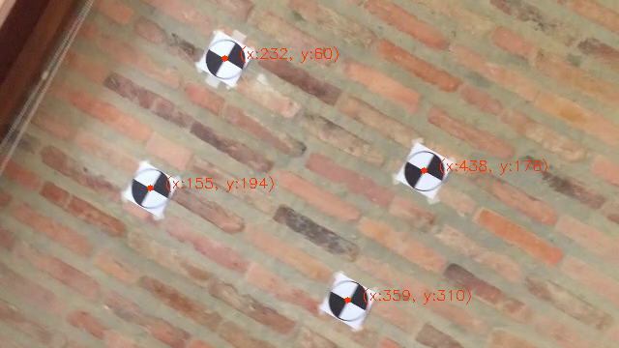
4: Markers in Video (cont.)
Youtube / Dropbox / etc. link:
https://gtvault-my.sharepoint.com/:v:/g/personal/ppatel480_gatech_edu/EUH_dJ-cWwpOuw7JiAbckcIBBVe-HpQ8nnw3knX9lFnWtQ?e=n5yggC
Short Link : Here
ps3-4-a-6
Computer Vision @ GT

Slide 13
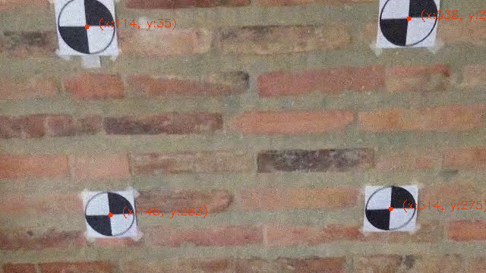
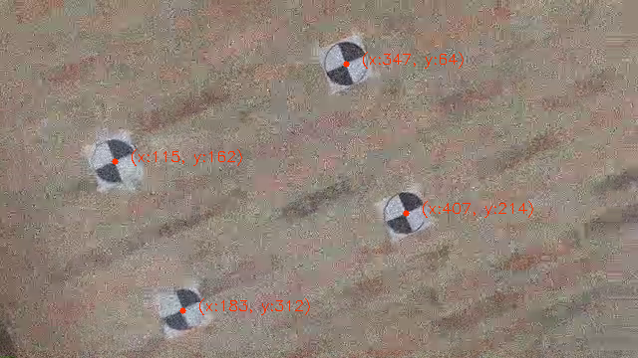
4: Markers in Video
ps3-4-b-1
ps3-4-b-2
Computer Vision @ GT

Slide 14
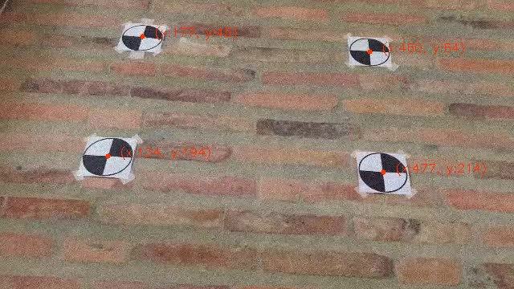
4: Markers in Video (cont.)
Youtube / Dropbox / etc. link:
https://gtvault-my.sharepoint.com/:v:/g/personal/ppatel480_gatech_edu/ERduLiGT60VNjjQeCiGokk0BQ9XPwCpzQovOIeki_LtkCg?e=f53Ti8
Short Link : Here
ps3-4-b-3
Computer Vision @ GT

Slide 15
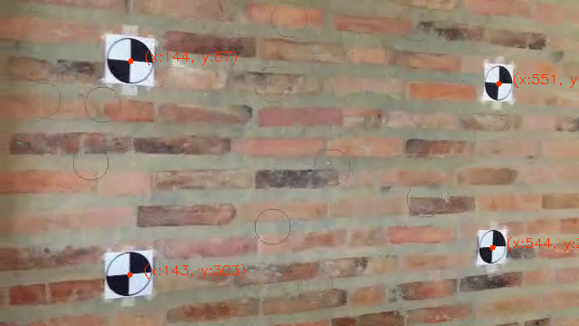
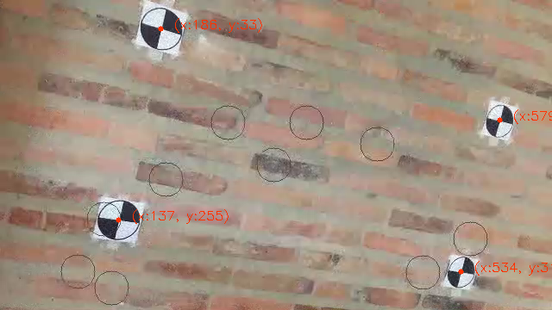
4: Markers in Video (cont.)
ps3-4-b-4
ps3-4-b-5
Computer Vision @ GT

Slide 16
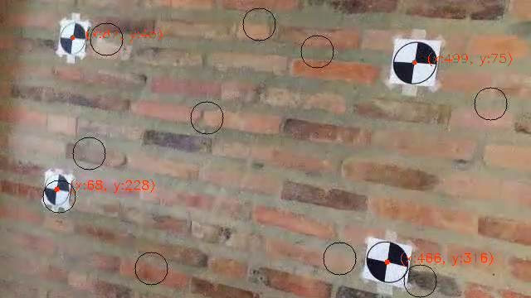
4: Markers in Video (cont.)
Youtube / Dropbox / etc. link:
https://gtvault-my.sharepoint.com/:v:/g/personal/ppatel480_gatech_edu/EdzV6zCSmtdPt276kssFnswBBv3EFIJJIhMoyR82Xd2emA?e=pJInrs
Short link : Here
ps3-4-b-6
Computer Vision @ GT

Slide 17
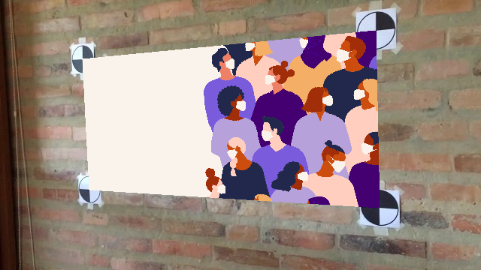

5: AR in Video
ps3-5-a-1
ps3-5-a-2
Computer Vision @ GT

Slide 18

5: AR in Video (cont.)
Youtube / Dropbox / etc. link:
https://gtvault-my.sharepoint.com/:v:/g/personal/ppatel480_gatech_edu/ERq1WMFJ4KtFvT9U5WAuzDUBTG4sOtZujYhiV9l1JtE3lw?e=rY0Vyv
Short Link : Here
ps3-5-a-3
Computer Vision @ GT

Slide 19


5: AR in Video (cont.)
ps3-5-a-4
ps3-5-a-5
Computer Vision @ GT

Slide 20
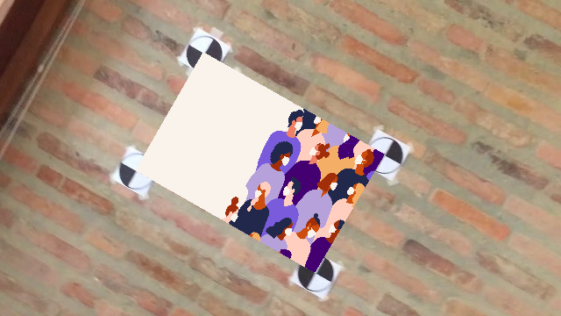
5: AR in Video (cont.)
Youtube / Dropbox / etc. link:
https://gtvault-my.sharepoint.com/:v:/g/personal/ppatel480_gatech_edu/EcXCHNRhzKJPjWBr4DlAuXUB6NwhgqUqiWjXCArmehi-sQ?e=DZNClB
Short Link : Here
ps3-5-a-6
Computer Vision @ GT

Slide 21

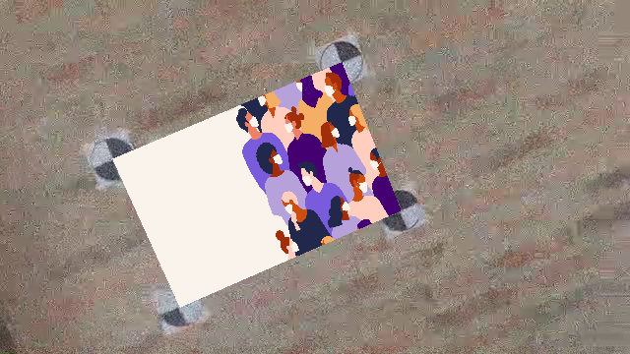
5: Markers in Video
ps3-5-b-1
ps3-5-b-2
Computer Vision @ GT

Slide 22
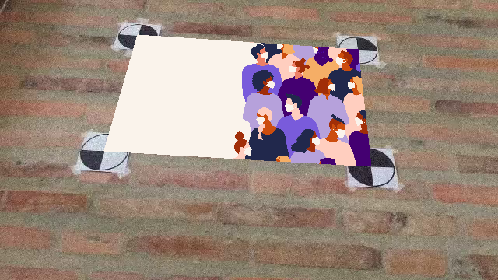
5: Markers in Video (cont.)
Youtube / Dropbox / etc. link:
https://gtvault-my.sharepoint.com/:v:/g/personal/ppatel480_gatech_edu/ESNcNG0bp81Nq4jLIz_NyiABQ3fZADDXA0-DJQgoen0raw?e=4eNTNd
Short Link : Here
ps3-5-b-3
Computer Vision @ GT

Slide 23

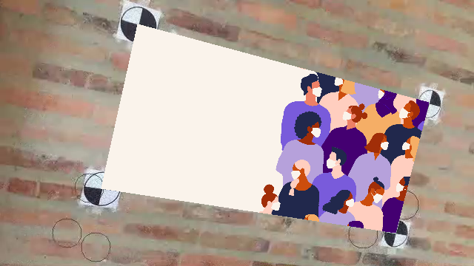
5: Markers in Video (cont.)
ps3-5-b-4
ps3-5-b-5
Computer Vision @ GT

Slide 24

5: Markers in Video (cont.)
Youtube / Dropbox / etc. link:
https://gtvault-my.sharepoint.com/:v:/g/personal/ppatel480_gatech_edu/ET_sbGl4Z7FOk130AM3mSLcBOhpvDI9G0mK1U0HrhsZhlQ?e=uUV60g
Short Link : Here
ps3-5-b-6
Computer Vision @ GT

Slide 25
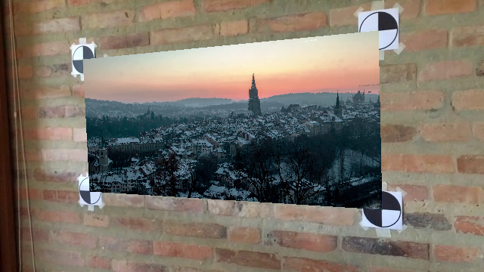
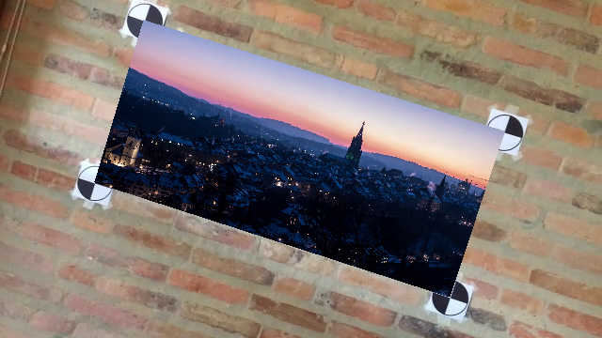
6: Video in Video
ps3-6-a-1
ps3-6-a-2
Computer Vision @ GT

Slide 26
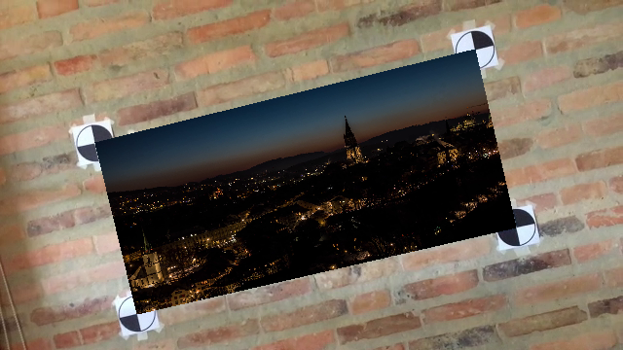
6: Video in Video (cont.)
Youtube / Dropbox / etc. link:
https://gtvault-my.sharepoint.com/:v:/g/personal/ppatel480_gatech_edu/EeA1JukijJpKn8Suzkf9nhsBvUERmEvJGnukq6jttehelg?e=CfF8Lr
Short Link : Here
ps3-6-a-3
Computer Vision @ GT

Slide 27
If your pdf is larger than 7MB
Please compress it using (or something similar):
https://smallpdf.com/compress-pdf
Verify that all images are still visible for grading.

